Slide 1
Fuzzy Control of Inverted Pendulum
Presented by: Tang, Qi
Student I.D.: M-B5-5515-2
Course: ELCE707 Advanced Control
Instructor: Dr. Wan
14/3/2016

Slide 2
Outline
Introduction & objectives
Modeling moves of IP
Solving non-linear ODE
Design fuzzy controller
Tuning system conditions for improvement
Input & output gain;
Comparison between Gaussian and triangular membership function;
Adjust scaling gains (g0, g1, h);
Increase rules from 5*5 to 7*7;
Conclusions
* Appendix of Matlab code

Slide 3
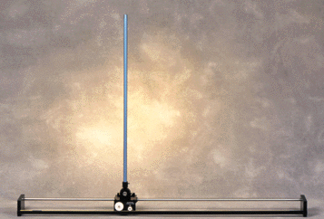
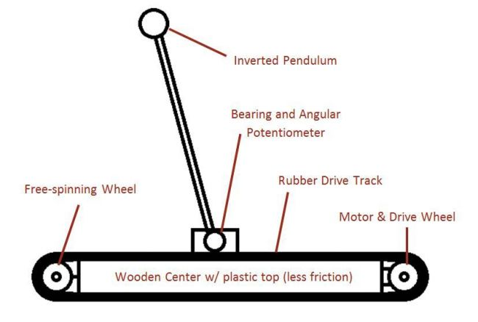
Introduction & objectives
Inverted pendulum on a cart:
length l pole pivoted on a horizontally moving base. The cart is restricted to linear motion and is subject to forces resulting in or hindering motion.
Design and examine performance of fuzzy controller in inverted pendulum system (IPS) to make the pole upright based on MATLAB simulation.

Slide 4
Outline
Introduction & objectives
Modeling moves of IP
Solving non-linear ODE
Design fuzzy controller
Tuning system conditions for improvement
Input & output gain;
Comparison between Gaussian and triangular membership function;
Adjust scaling gains (g0, g1, h);
Increase rules from 5*5 to 7*7;
Conclusions
* Appendix of Matlab code

Slide 5
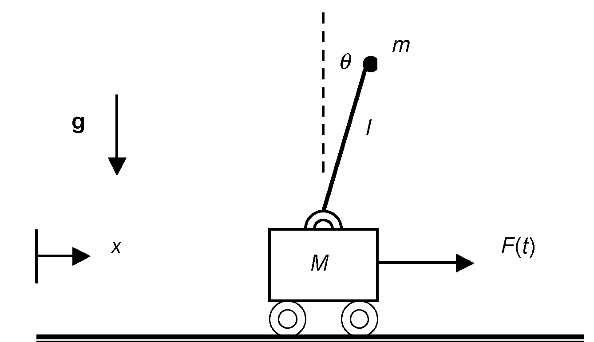
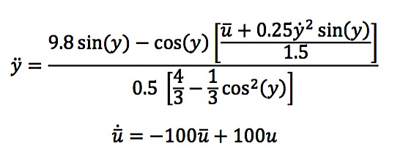

Modeling moves of IP
In ideal condition:
No internal friction;
The pole is modeled as a thin rod;
The horizontal axis is enough long ;

Slide 6
Outline
Introduction & objectives
Modeling moves of IP
Solving non-linear ODE
Design fuzzy controller
Tuning system conditions for improvement
Input & output gain;
Comparison between Gaussian and triangular membership function;
Adjust scaling gains (g0, g1, h);
Increase rules from 5*5 to 7*7;
Conclusions
* Appendix of Matlab code

Slide 7

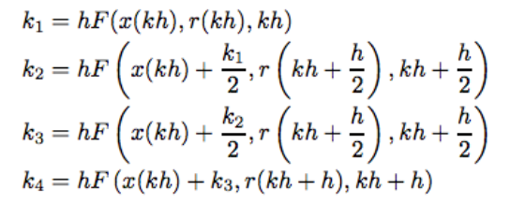
Solving non-linear ODE
Runge- Kutta iteration method:
ODE 45:
Based on Runge-Kutta (4,5) formula;
Single step solver: in computing y(tn);
Needs only the solution at the immediately preceding time point, y(tn-1);

Slide 8
Outline
Introduction & objectives
Modeling moves of IP
Solving non-linear ODE
Design fuzzy controller
Tuning system conditions for improvement
Input & output gain;
Comparison between Gaussian and triangular membership function;
Adjust scaling gains (g0, g1, h);
Increase rules from 5*5 to 7*7;
Conclusions
* Appendix of Matlab code

Slide 9
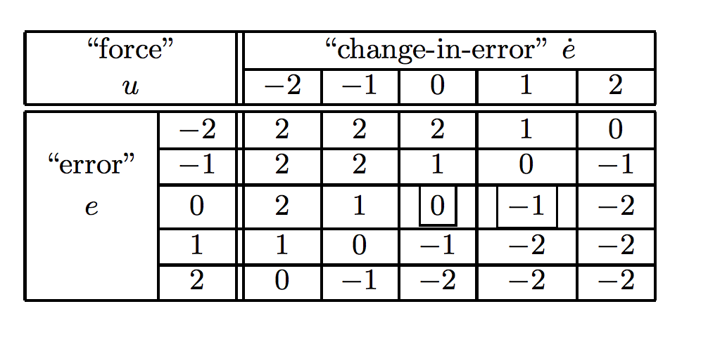
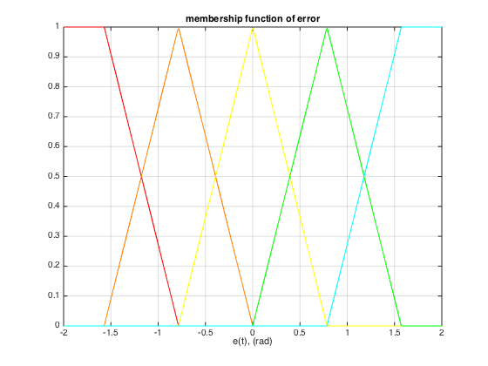
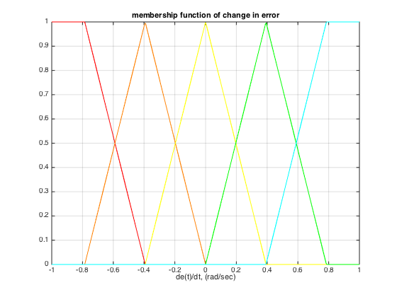
Design fuzzy controller( Linguistic to rule base)
TABLE.01 5*5 Rule Table for the Inverted Pendulum
Input Membership Functions with Input Values (e & e’)

Slide 10
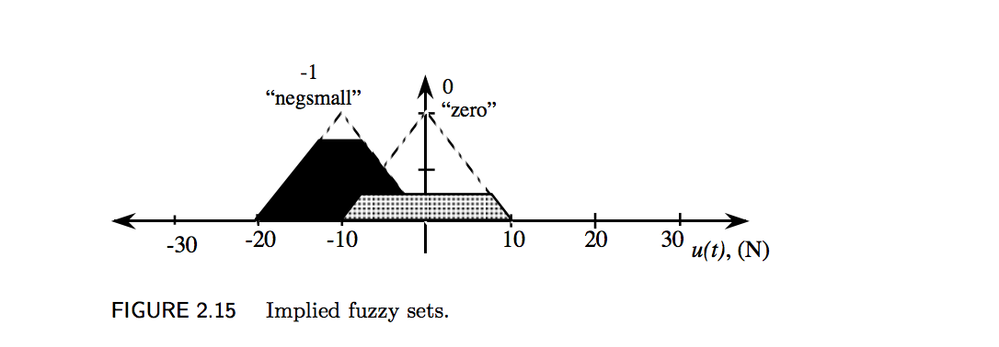
Design fuzzy controller( premises/ defuzzification)
Minimum or product
The premises of the initial condition (y(0) = 0.1 radians (= 5.73 deg.), ˙y(0) = 0) is:
premise =
0 0 0 0 0
0 0 0.1273 0 0
0 0 0.8727 0 0
0 0 0 0 0
0 0 0 0 0

Slide 11
Outline
Introduction & objectives
Modeling moves of IP
Solving non-linear ODE
Design fuzzy controller
Tuning system conditions for improvement
Input & output gain;
Comparison between Gaussian and triangular membership function;
Adjust scaling gains (g0, g1, h);
Increase rules from 5*5 to 7*7;
Conclusions
* Appendix of Matlab code

Slide 12
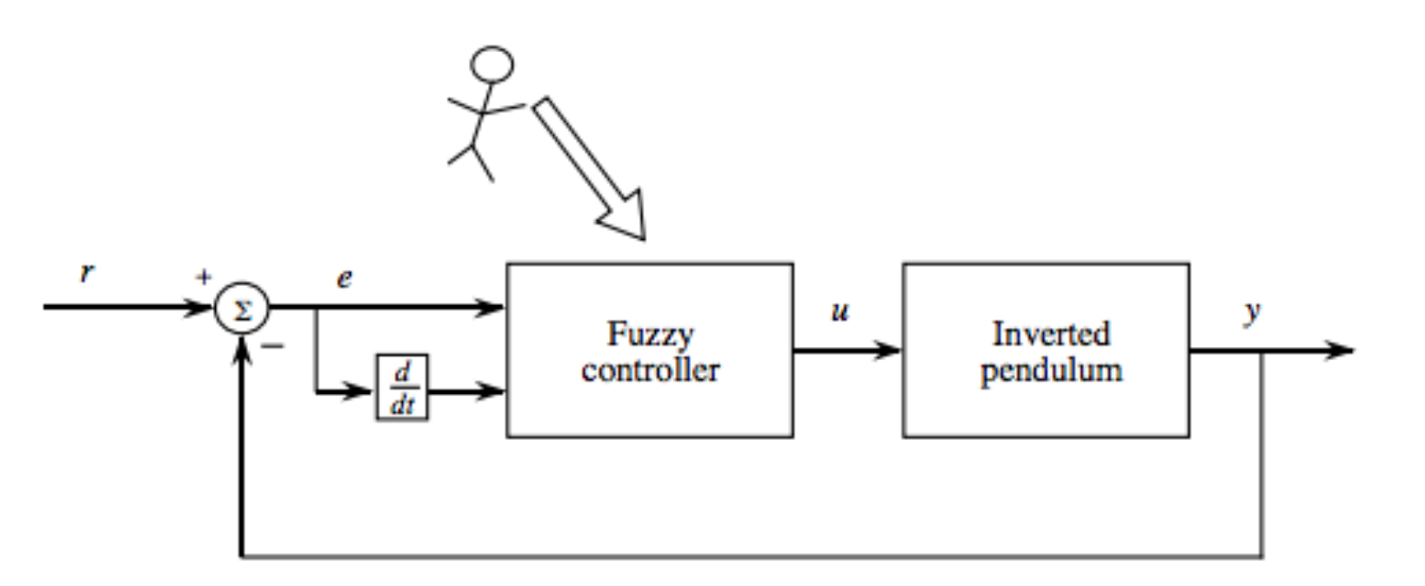
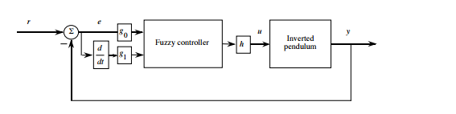
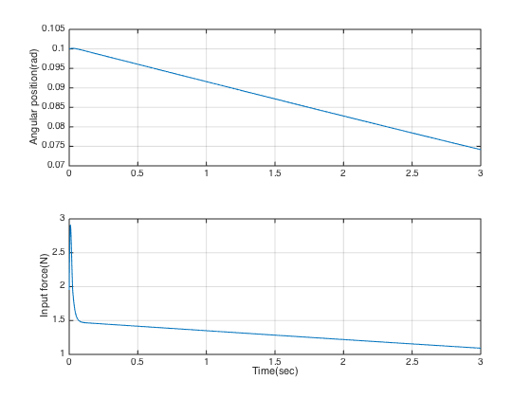
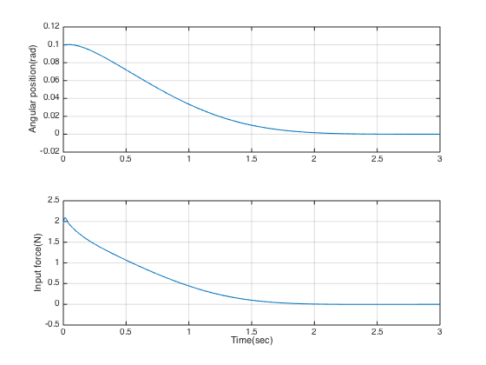
Tuning system for improvement (input&output gain)
e= 0.1 rad, e’=0 rad/s
response of first design system
System response with scaling gains g0=1, g1=0.1, and h=1

Slide 13
Tuning system for improvement (MF functions)
Gaussian membership functions

Slide 14
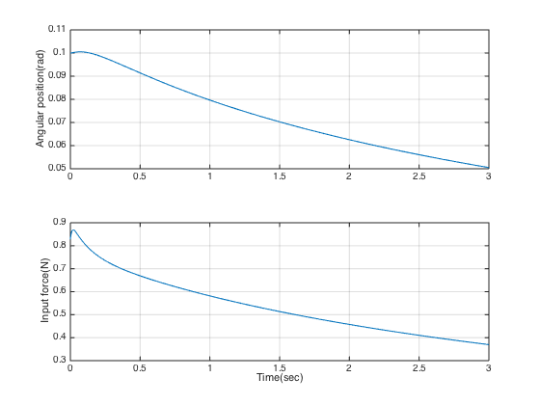
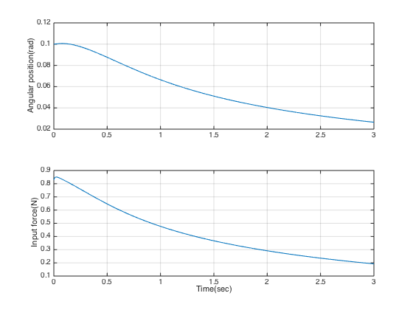
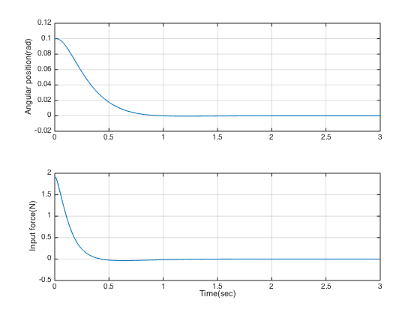
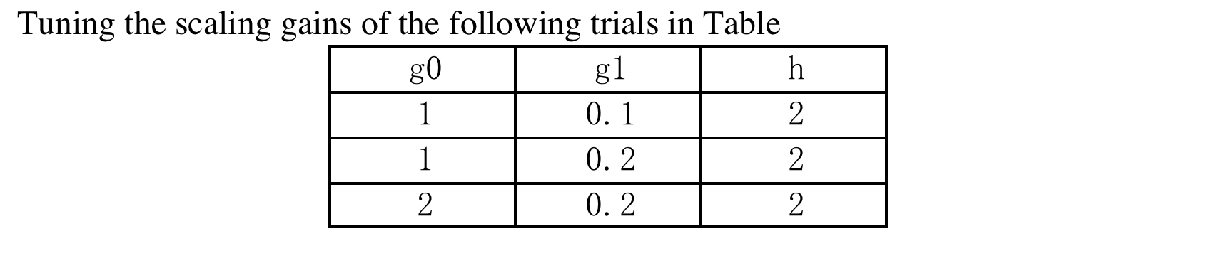
Tuning system for improvement (adjust scaling gains)
Gaussian MF with scaling gains g0=1, g1=0.2, and h=2
Gaussian MF with scaling gains g0=1, g1=0.1, and h=2
Gaussian MF with scaling gains g0=2, g1=0.1, and h=2

Slide 15
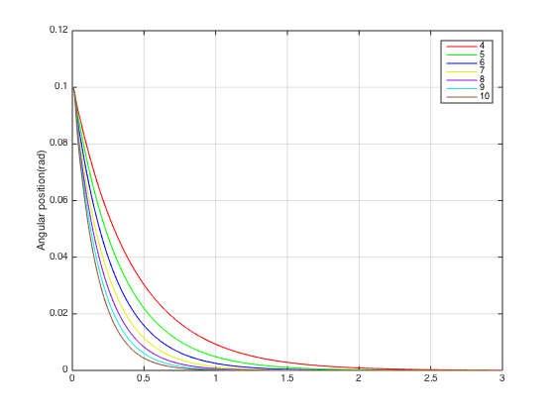
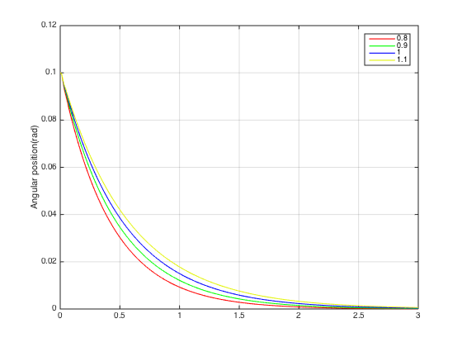
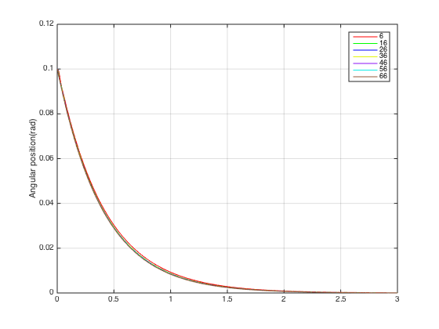
Tuning system for improvement (adjust scaling gains)
error gain g0=4-10, g1=0.8, h=6
g0=4,gain of e’ g1=0.8-1.4, h=6
g0, h ⬆️
g1 ⬇ ️
g0=4, g1=0.8,output gain h=6-66

Slide 16
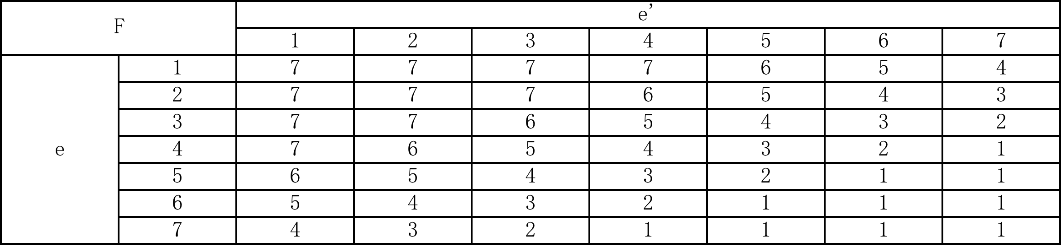
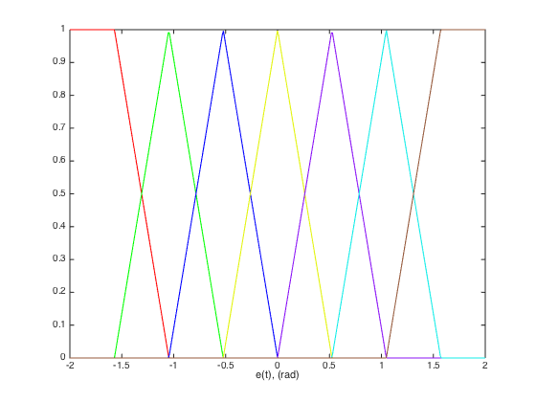
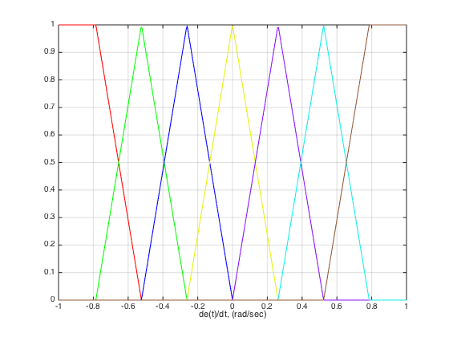
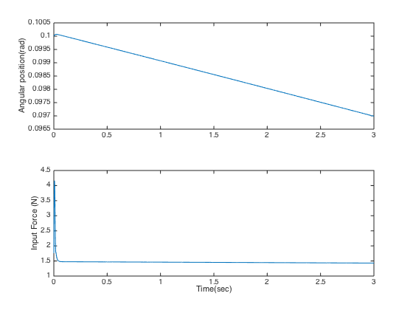
Tuning system for improvement (7*7 rule base)
TABLE. 7*7 Rule Table for the Inverted Pendulum:
Input membership function of angular position
Input membership function of angular speed
triangular MF with 7*7 rule bases

Slide 17
Outline
Introduction & objectives
Modeling moves of IP
Solving non-linear ODE
Design fuzzy controller
Tuning system conditions for improvement
Input & output gain;
Comparison between Gaussian and triangular membership function;
Adjust scaling gains (g0, g1, h);
Increase rules from 5*5 to 7*7;
Conclusions
* Appendix of Matlab code

Slide 18
Conclusions
triangular MF with 5*5 rule bases
triangular MF with 7*7 rule bases

Slide 19
Thank you

